Slide 1

Sales Financial Dashboard
Designed in Power BI for Business Stakeholders
Presented by :
Surjeetsinh Nandkumar Thakur

Slide 2
TABLE OF CONTENTS
INTRODUCTION
PROBLEM DEFINITION
ALGORITHM
METHODOLOGY
ABOUT TO IMPLEMENTATION OF PROJECT
DASHBOARD OVERVIEW IMAGES
CASE STUDY
CONCLUSION
REFERENCES

Slide 3
Introduction
The rapid evolution of data analytics tools has enabled organizations to gain better insights into their operations.
Sales and financial data hold key information about performance and trends.
This project focuses on designing an interactive dashboard that can help stakeholders monitor KPIs effectively.
The dashboard was built using Power BI, one of the leading tools for Business Intelligence.

Slide 4
Problem Definition
Traditional reporting lacks real-time insights.
Business users face difficulty identifying trends quickly.
Need for a centralized, dynamic solution to visualize key metrics.
Businesses generate large volumes of sales and financial data daily.
Traditional reporting systems are static, time-consuming, and lack interactivity.
Stakeholders often struggle to extract timely insights due to scattered or unstructured data.

Slide 5
Algorithm
Data Cleaning : Removed null values, duplicates, and inconsistencies using Power Query.
KPI Calculations (DAX) :
- Total Sales = SUM(Sales)
- Total Profit = SUM(Gross Income)
- Growth % = (Current Month Sales - Previous Month Sales) / Previous Month Sales
- Profit Margin = (Gross Income / Sales) * 100
- Average Rating = AVERAGE(Rating)
Filtering : Applied filters using slicers and calculated columns.

Slide 6
Methodology
Step 1: Data Acquisition : Source: Kaggle - Sales Financial Dataset.
Step 2: Data Modeling :
Structured the data using Power BI’s data model.
Created relationships between date, product line, customer, and transactions.
Step 3: Visualization :
Designed visuals such as KPI cards, line charts, clustered bar charts, donut charts.

Slide 7
Methodology
Step 4: Interactivity :
Enabled filters for city, product, date, gender, and customer type.
Step 5: Dashboard Integration :
Created navigation buttons and bookmarks for seamless access.

Slide 8
About the Implementation of Project
Power BI used for developing an end-to-end analytics dashboard.
Dataset cleaned and transformed using Power Query Editor.
The dashboard consists of multiple pages including KPI Overview, Product Analysis, and Branch Analysis.
Data was transformed using Power Query and enriched with DAX measures.
Each visual is linked to slicers allowing dynamic analysis.
Cards display real-time aggregates like total sales and profits.

Slide 9
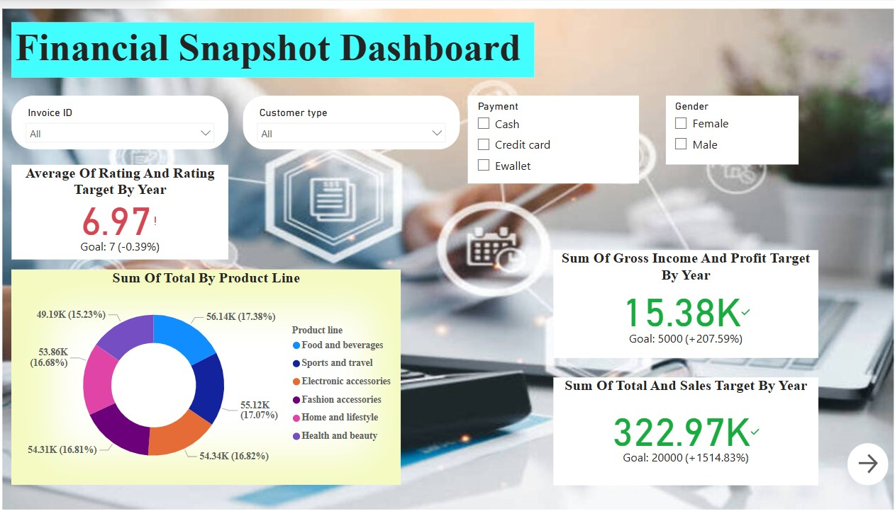
Dashboard Overview Images

Slide 10
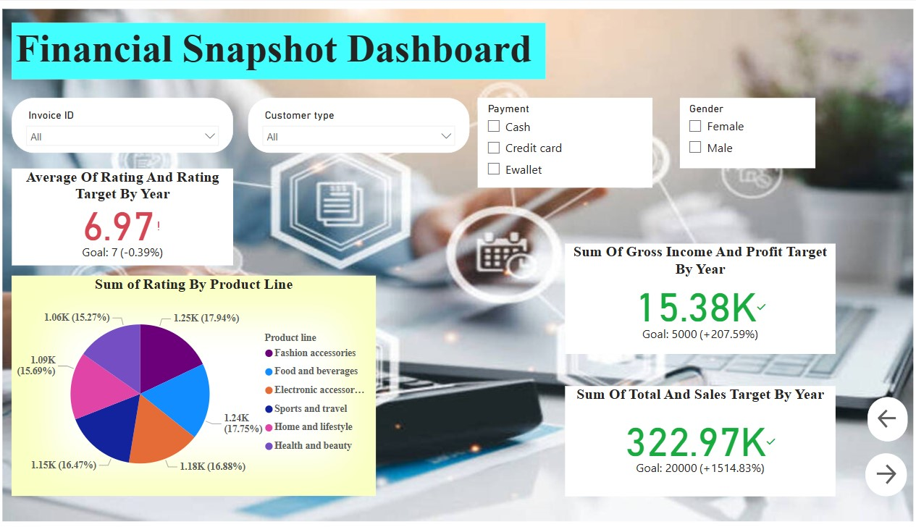

Slide 11
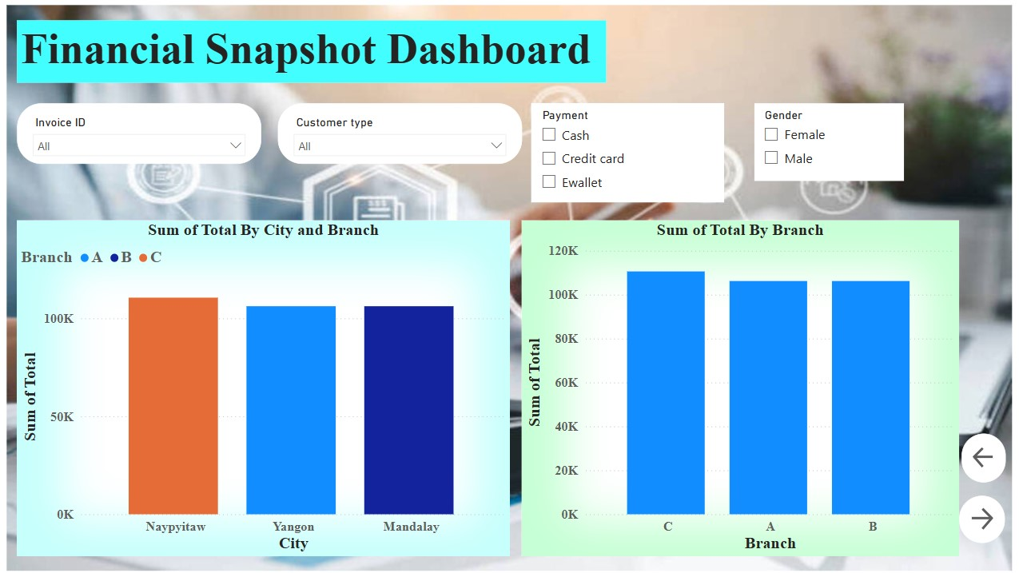

Slide 12
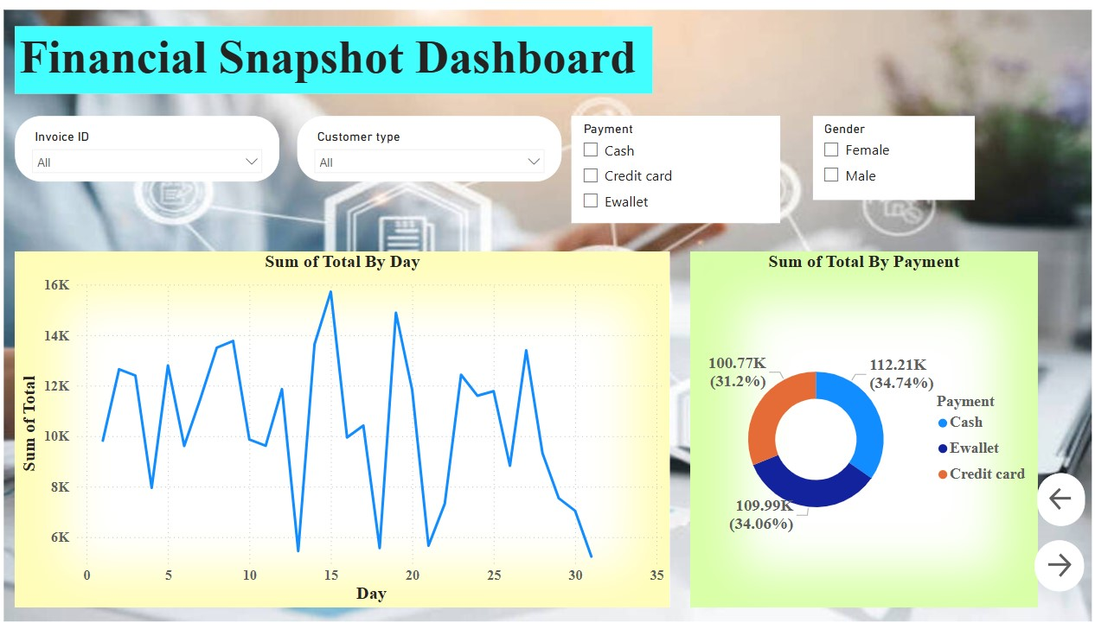

Slide 13
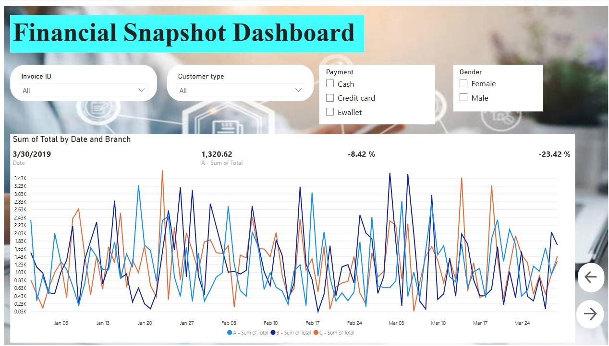

Slide 14
Case Study
Objective: Analyze which branch and product line perform best.
Findings :
Branch A had the highest total sales and gross income.
Health and Beauty consistently ranked top in revenue.
Members spent more on average than non-members.
Ewallet was the preferred mode of payment across cities.
Ratings were higher for Fashion Accessories.
These insights help stakeholders make product and marketing decisions.

Slide 15
Conclusion
Developed an insightful Power BI dashboard to visualize key business metrics.
Enabled interactivity to allow dynamic analysis of performance.
Leveraged DAX and Power Query to perform complex calculations.
Real-time visuals and filters support strategic decisions.
Gained valuable experience in BI tools, storytelling, and design principles.

Slide 16
References
Kaggle Dataset: Sales Financial Dataset.
Microsoft Power BI Documentation.
DAX Guide (SQLBI).
Community Blogs and Forums.

Slide 17
Thank You!

